Slide 1
Introduction to e-business and e-commerce

Slide 2
Learning outcomes
Define the meaning and scope of e-business and e-commerce and their different elements
Summarize the main reasons for adoption of e-commerce and e-business and barriers that may restrict adoption
Use resources to define the extent of adoption of the Internet as a communications medium for consumers and businesses
Outline the business challenges of introducing e-business and e-commerce to an organization.

Slide 3
Management issues
How do we explain the scope and implications of e-business and e-commerce to staff?
What is the full range of benefits of introducing e-business and what are the risks?
How great will the impact of the Internet be on our business? What are the current and predicted adoption levels?

Slide 4
E-business opportunities
Reach:
  Over 1 billion users globally
  Connect to millions of products
Richness
  Detailed product information on 20 billion + pages indexed by Google. Blogs, videos, feeds…
  Personalised messages for users
Affiliation
  Partnerships are key in the networked economy

Slide 5
The impact of the Internet on business
Andy Grove, Chairman of Intel, one of the early adopters of e-commerce, has made a meteorological analogy with the Internet. He says:
The Internet a typhoon force, a ten times force, or is it a bit of wind? Or is it a force that fundamentally alters our business? (Grove, 1996)

Slide 6
What is E-commerce and E-business
You are attending a role in the
e-business team of a global bank
You anticipate you may be asked the distinction between e-commerce and
e-business.
Write down a definition for each:
E-commerce:
E-business:

Slide 7
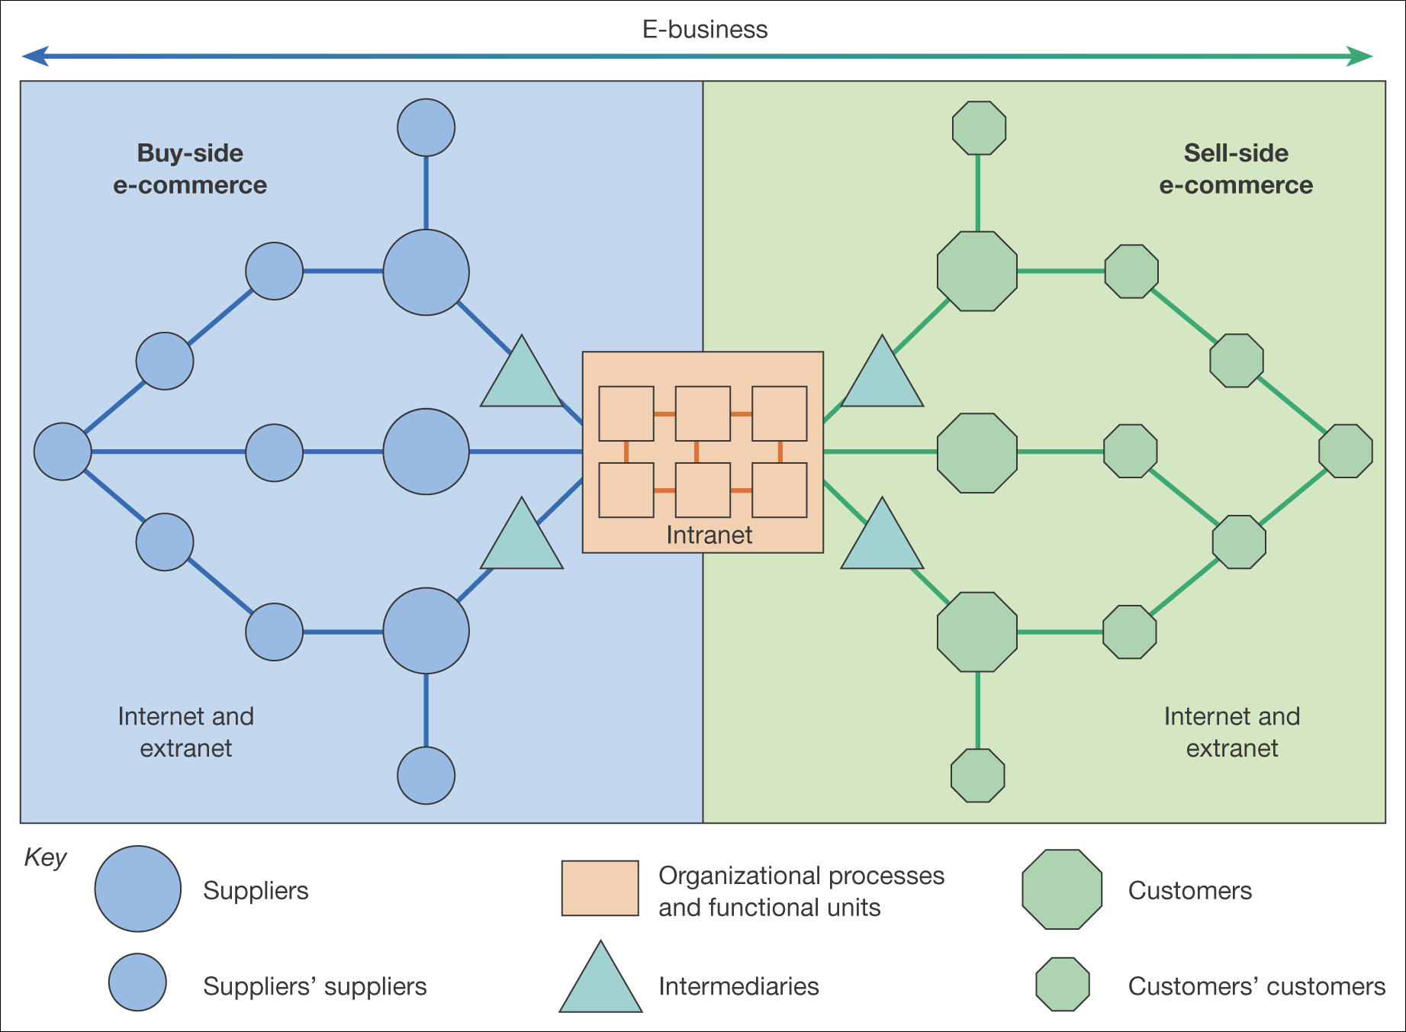
Figure 1.1 The distinction between buy-side and sell-side e-commerce

Slide 8
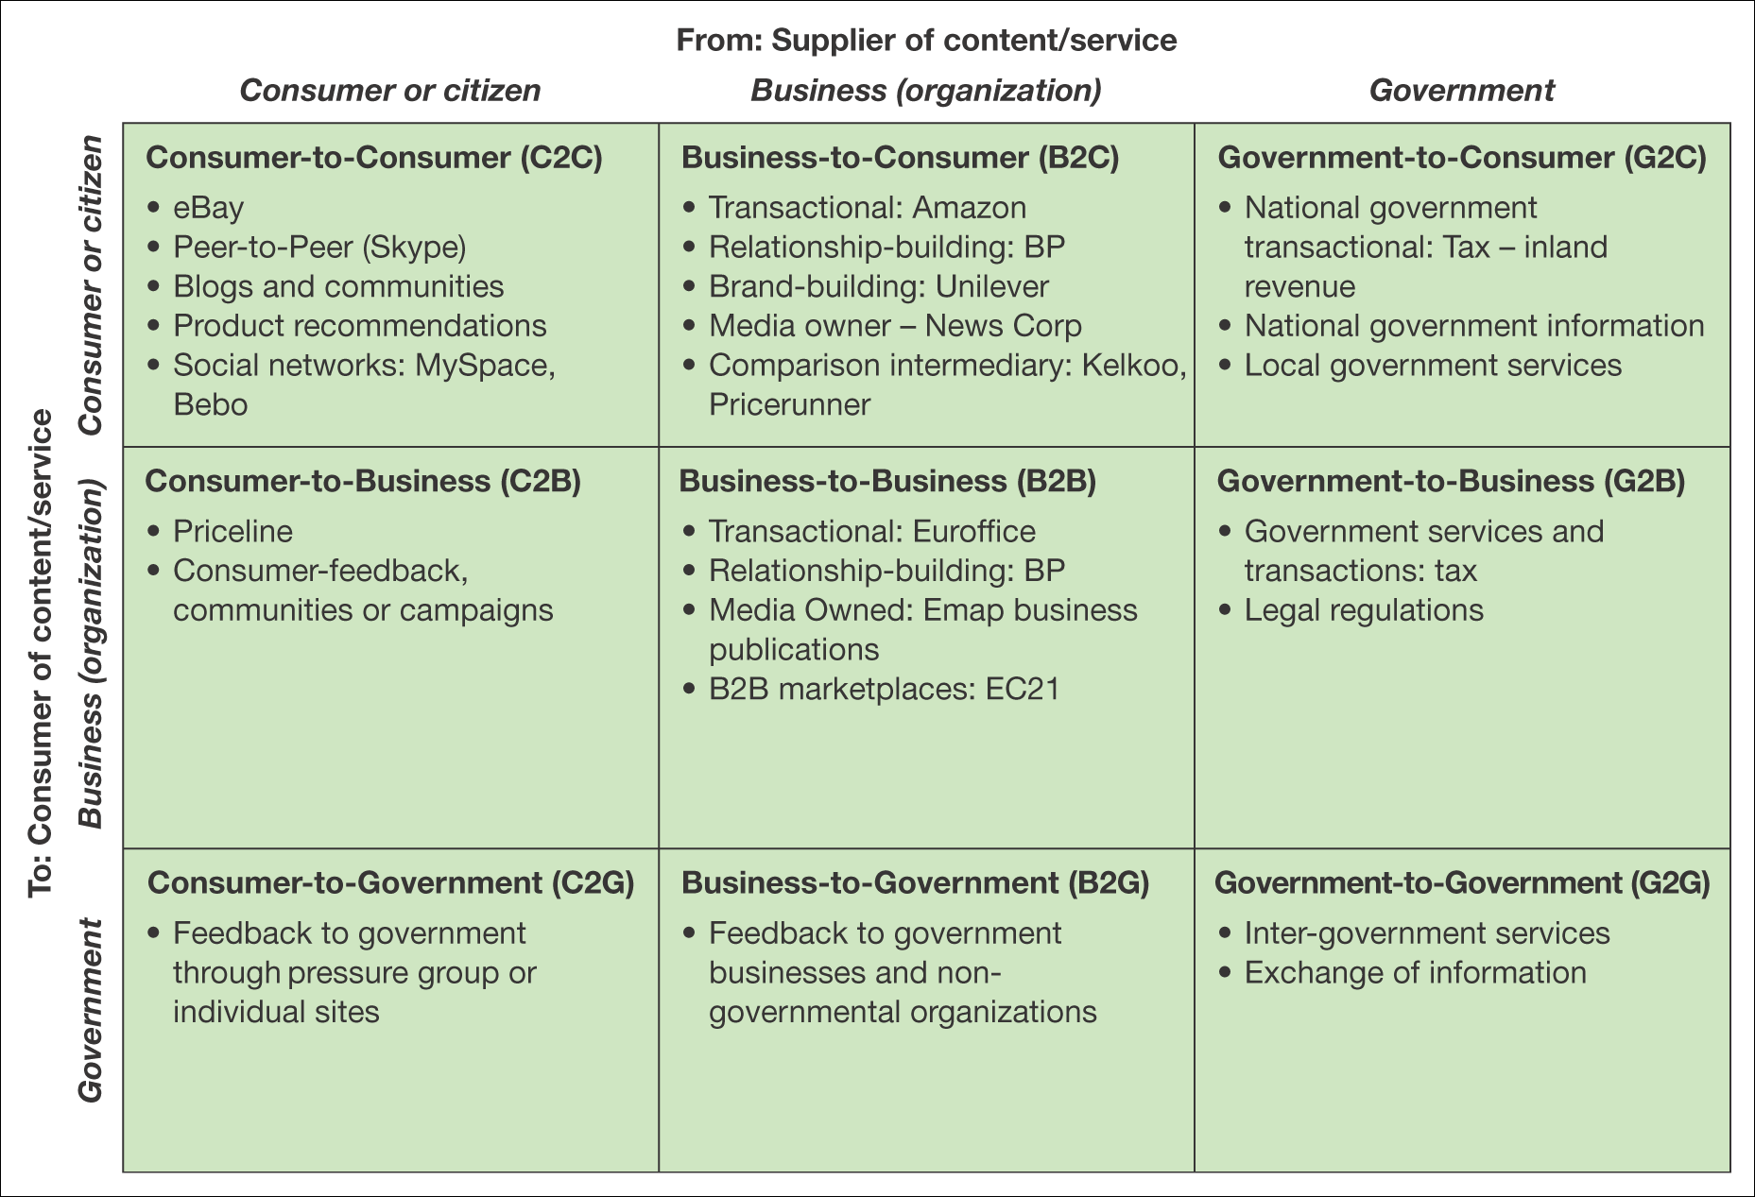
Figure 1.2 Summary and examples of transaction alternatives between businesses, consumers and governmental organizations

Slide 9
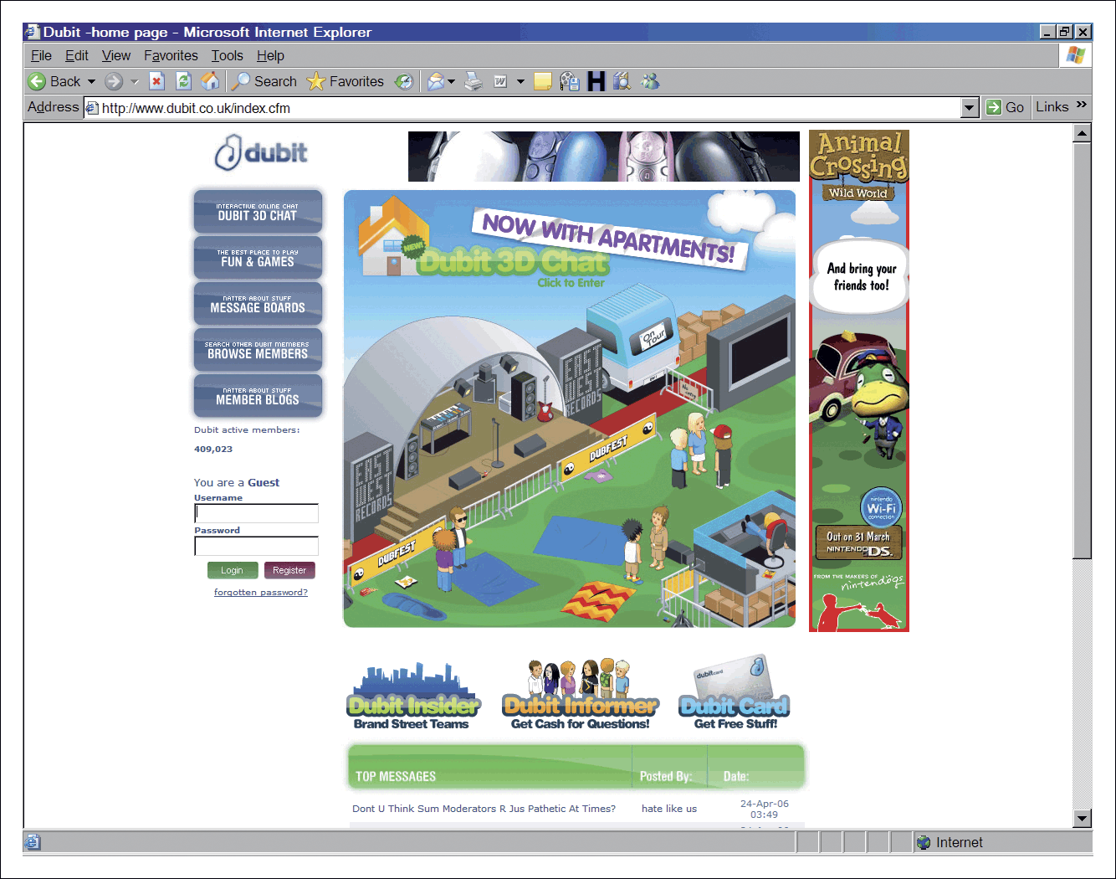
Figure 1.3 Dubit C2C site for a youth audience (www.dubit.co.uk)

Slide 10
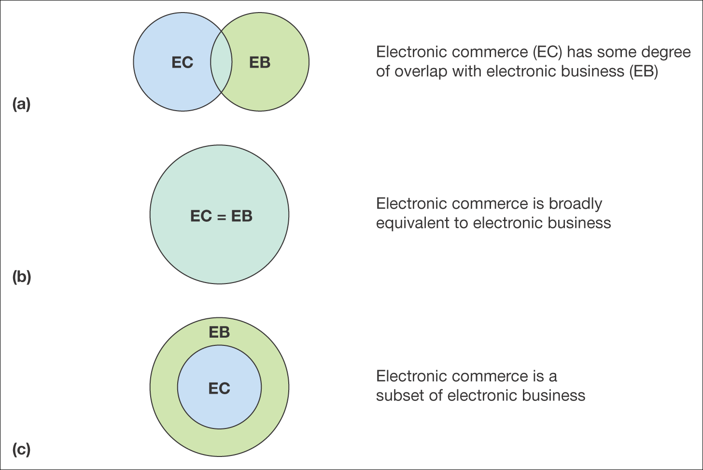
Figure 1.4 Three definitions of the relationship between e-commerce and e-business

Slide 11
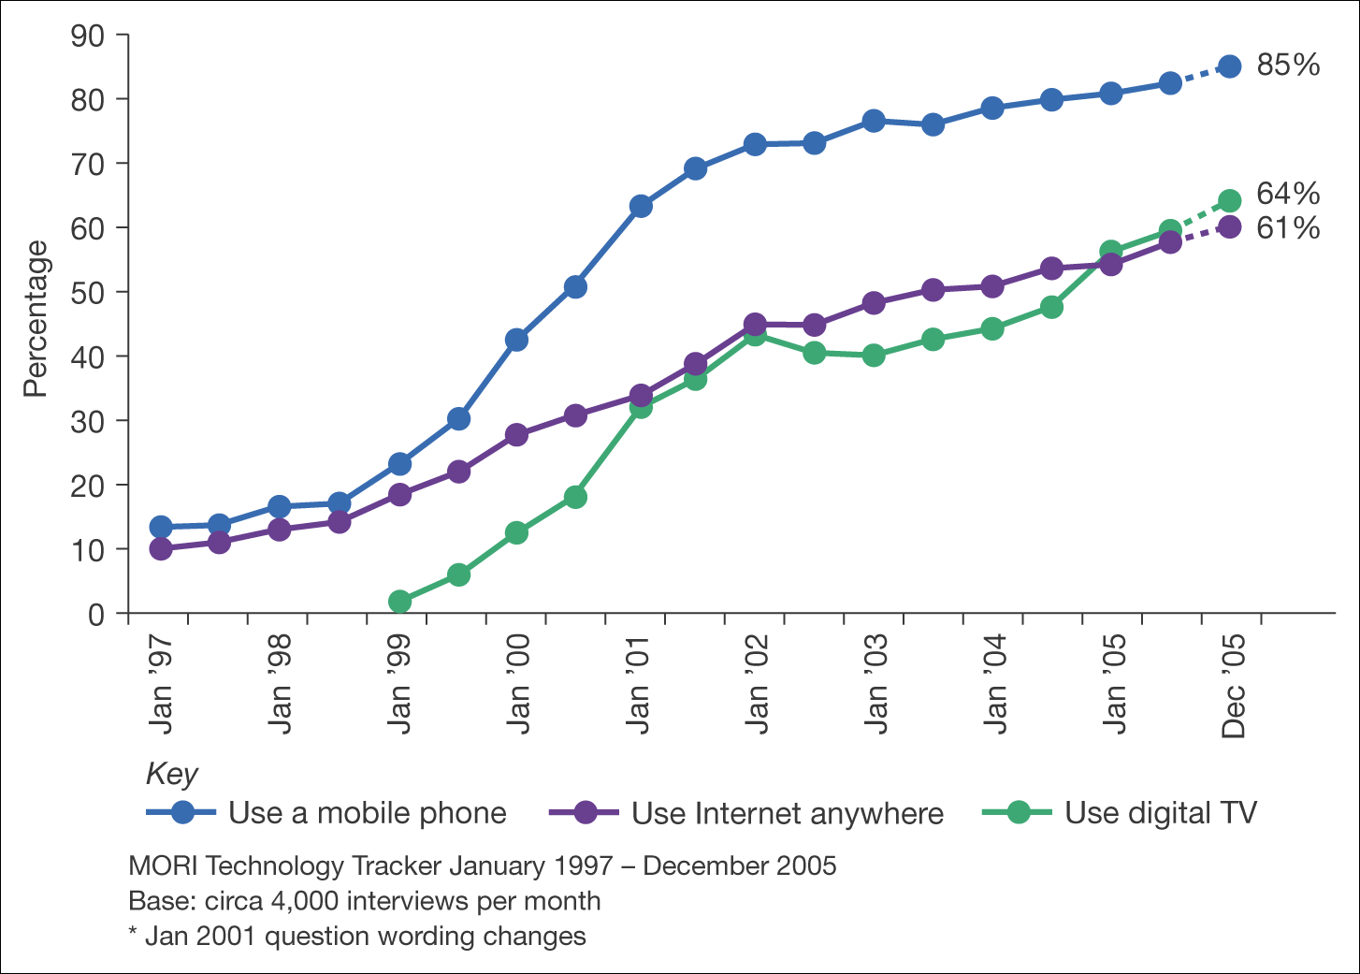
Figure 1.5 UK rate of adoption of different digital media
Source: MORI Technology Tracker, January 2006. See www.mori.com/technology/techtracker.shtml for latest details

Slide 12
Activity – drivers and barriers to adoption
You are in a team of advisers at a local business link (a local government agency encouraging adoption of e-commerce)
List:
  Drivers to adoption of sell-side e-commerce by business and how you can reinforce these by marketing benefits.
  Barriers to adoption of sell-side e-commerce by business and how you can reinforce these by stressing benefits.

Slide 13
Cost/efficiency and competitiveness drivers
Cost/efficiency drivers
  Increasing speed with which supplies can be obtained
  Increasing speed with which goods can be dispatched
  Reduced sales and purchasing costs
  Reduced operating costs.
Competitiveness drivers
  Customer demand
  Improving the range and quality of services offered
  Avoid losing market share to businesses already using e-commerce.

Slide 14
Tangible and intangible benefits
Tangible benefits | Intangible benefits
● Increased sales from new sales leads giving rise to increased revenue from: – new customers, new markets – existing customers (repeat-selling) – existing customers (cross-selling).  Marketing cost reductions from: – reduced time in customer service – online sales – reduced printing and distribution costs of marketing communications.  Supply-chain cost reductions from: – reduced levels of inventory – increased competition from suppliers – shorter cycle time in ordering.  Administrative cost reductions from more efficient routine business processes such as recruitment, invoice payment and holiday authorization. | ● Corporate image communication  Enhancement of brand  More rapid, more responsive marketing communications including PR  Faster product development lifecycle enabling faster response to market needs  Improved customer service  Learning for the future  Meeting customer expectations to have a web site  Identifying new partners, supporting existing partners better  Better management of marketing information and customer information  Feedback from customers on products

Slide 15
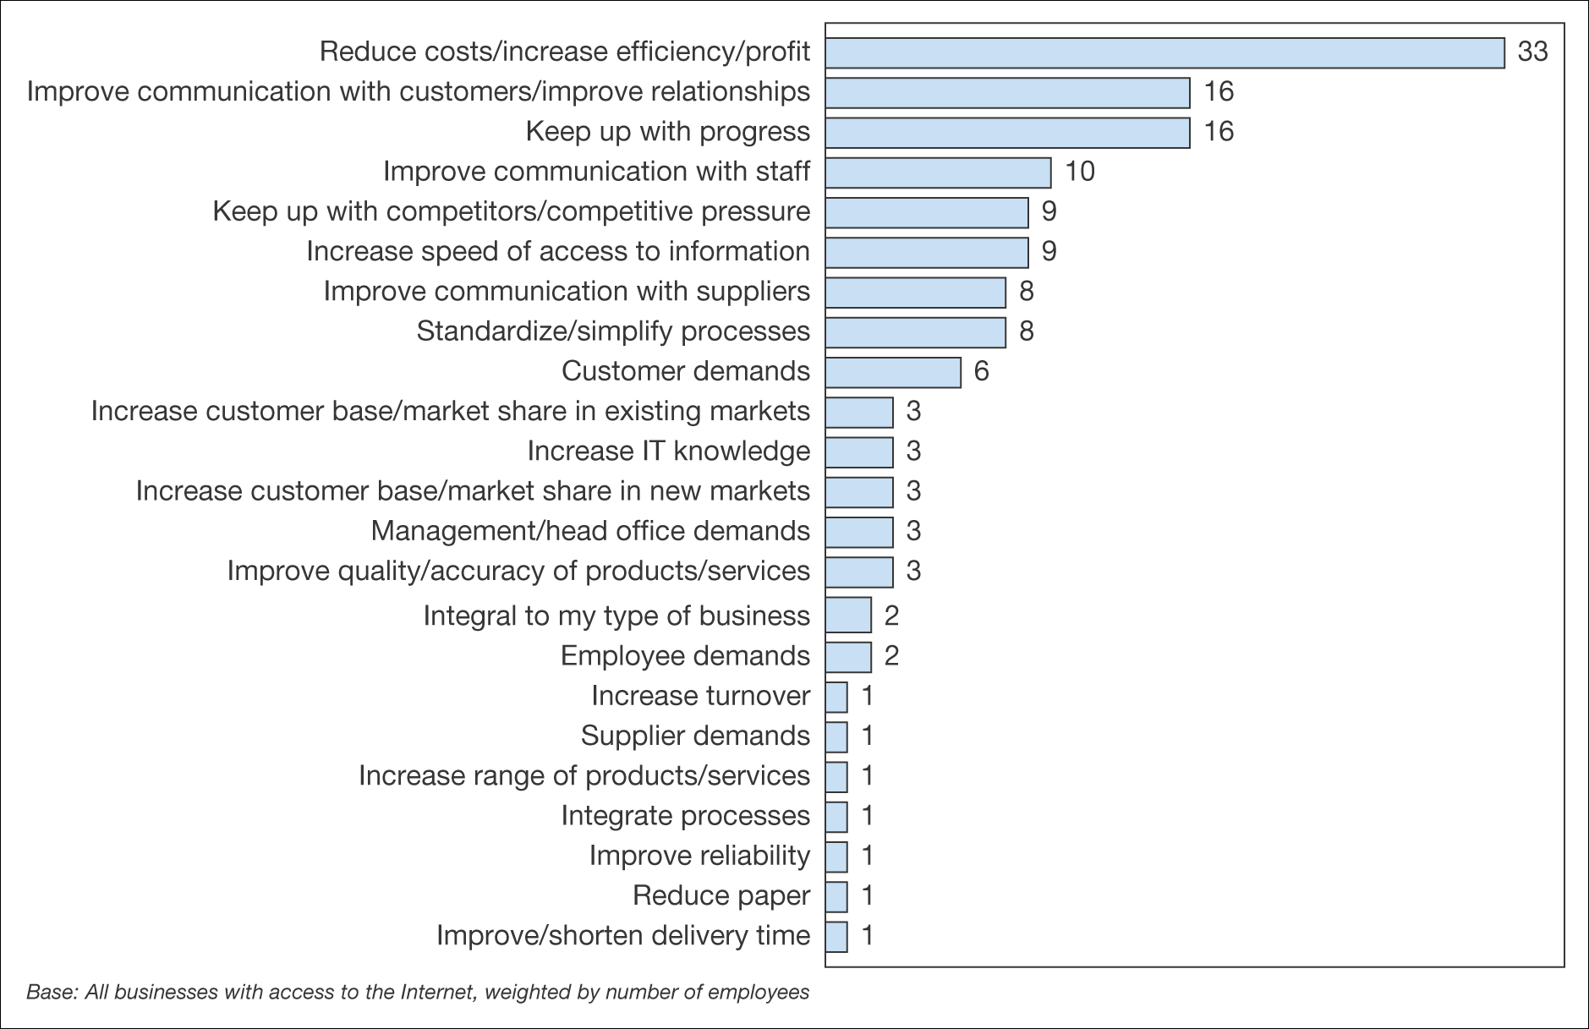
Figure 1.6 Attitudes to business benefits of online technologies
Source: DTI (2002)

Slide 16
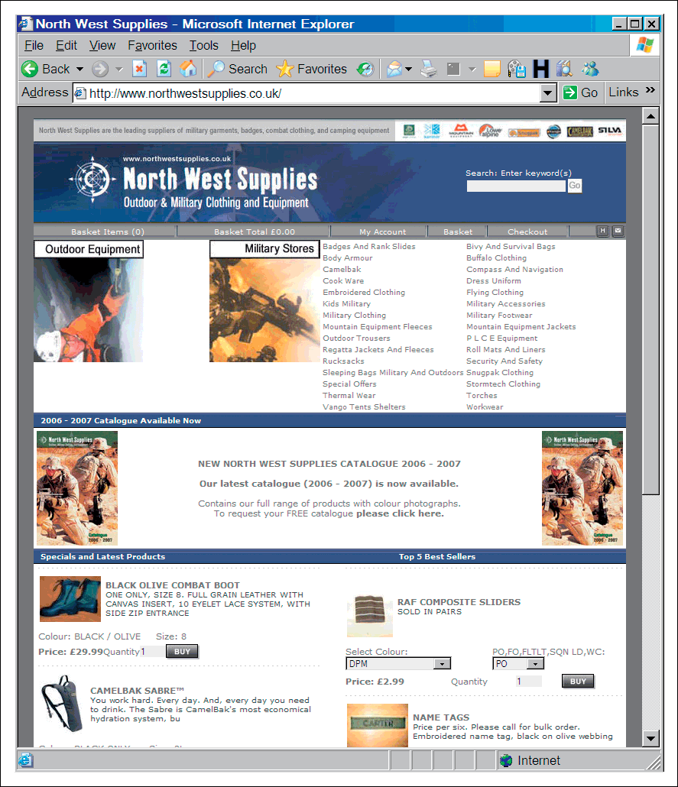
Figure 1.7 North West Supplies Ltd site (www.northwestsupplies.co.uk)
Source: Opportunity Wales

Slide 17
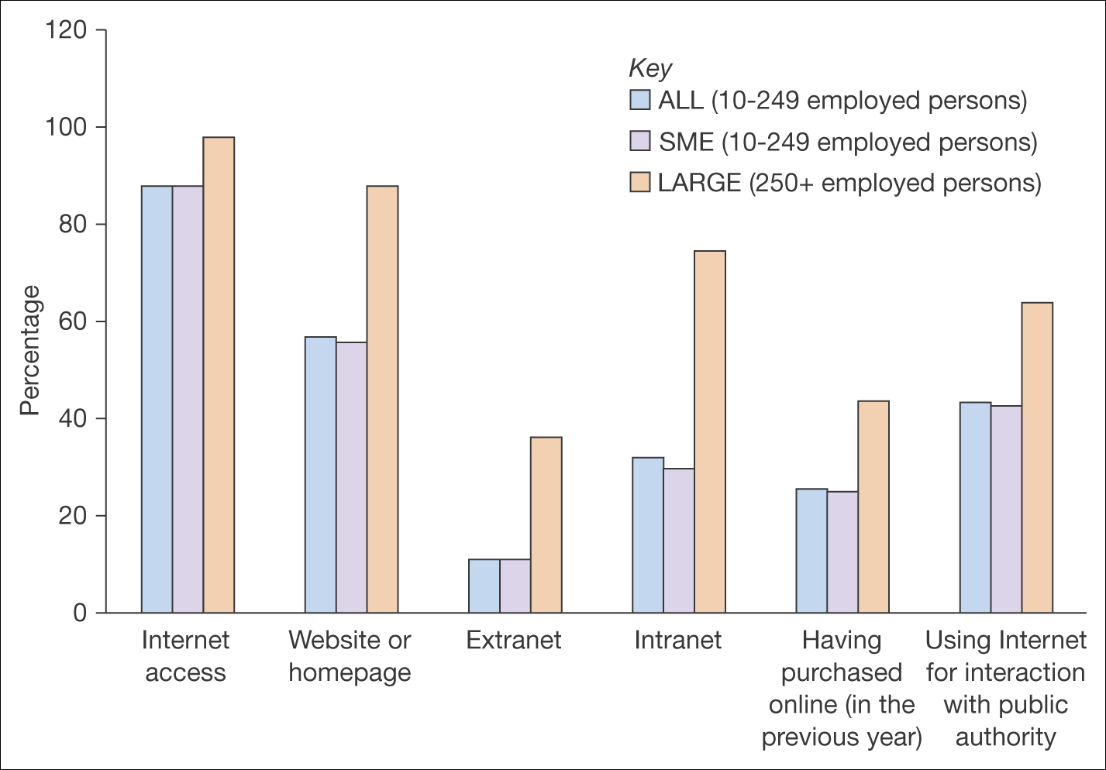
Figure 1.8 Adoption of Internet and e-business services across Europe
Source: Eurostat, Community Survey on ICT usage in enterprises, eEurope (2005) Information Society Benchmarking Report, © European Communities 2005, http://europa.eu.int/information_society

Slide 18
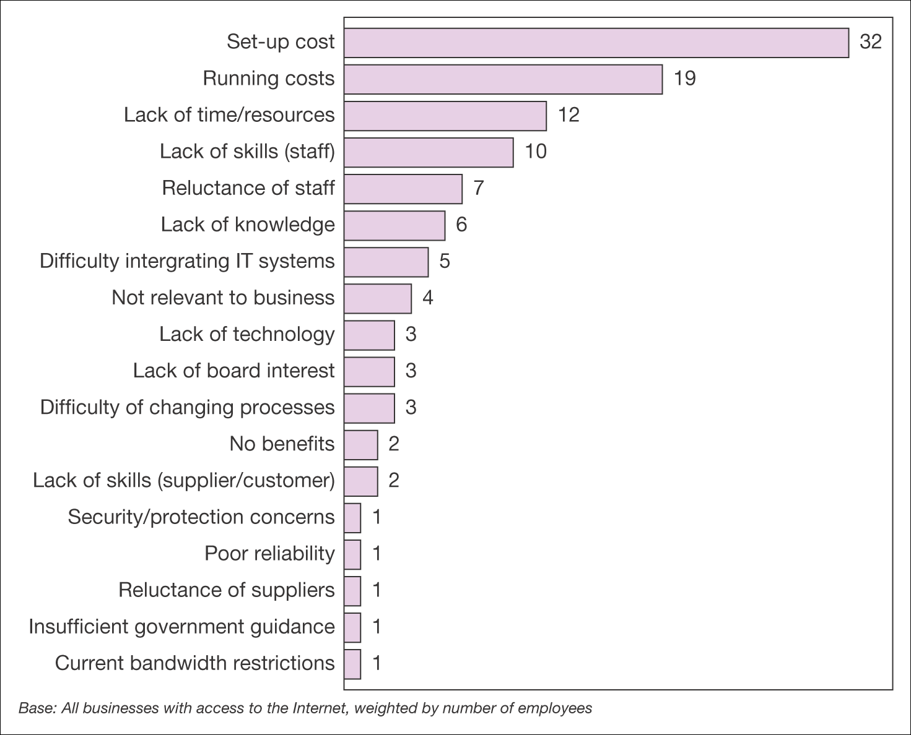
Figure 1.9 Barriers to development of online technologies
Source: DTI (2002)

Slide 19
Intro to B2B Company
Employs 600 people worldwide
Turnover £100m
Products – composites and speciality polymers
  See www.globalcomposites.com
Distribution – 90 companies worldwide via joint ventures and agents
Competitors:
  Derakan (www.dow.com/derakane)
  Scott Bader (www.scottbader.com)
  Owens Corning (www.owenscorning.com)

Slide 20
Intro to B2C Company
Established 1984, 80 staff
Products – Kitchenware
Distribution
  Through retailers and transactional web sites
Competitors
  Cooking.com (www.cooking.com)
  Lakeland (www.lakelandlimited.com)
  Tupperware (www.tupperware.com).

Slide 21
Activity – Benefits to B2B and B2C Company
See activity 1.5
Give examples of these benefits of an online presence. Which of these are most important to each:
  Cost reduction
  New capability
  Communication
  Customer service
  Control
  Competitive advantage

Slide 22
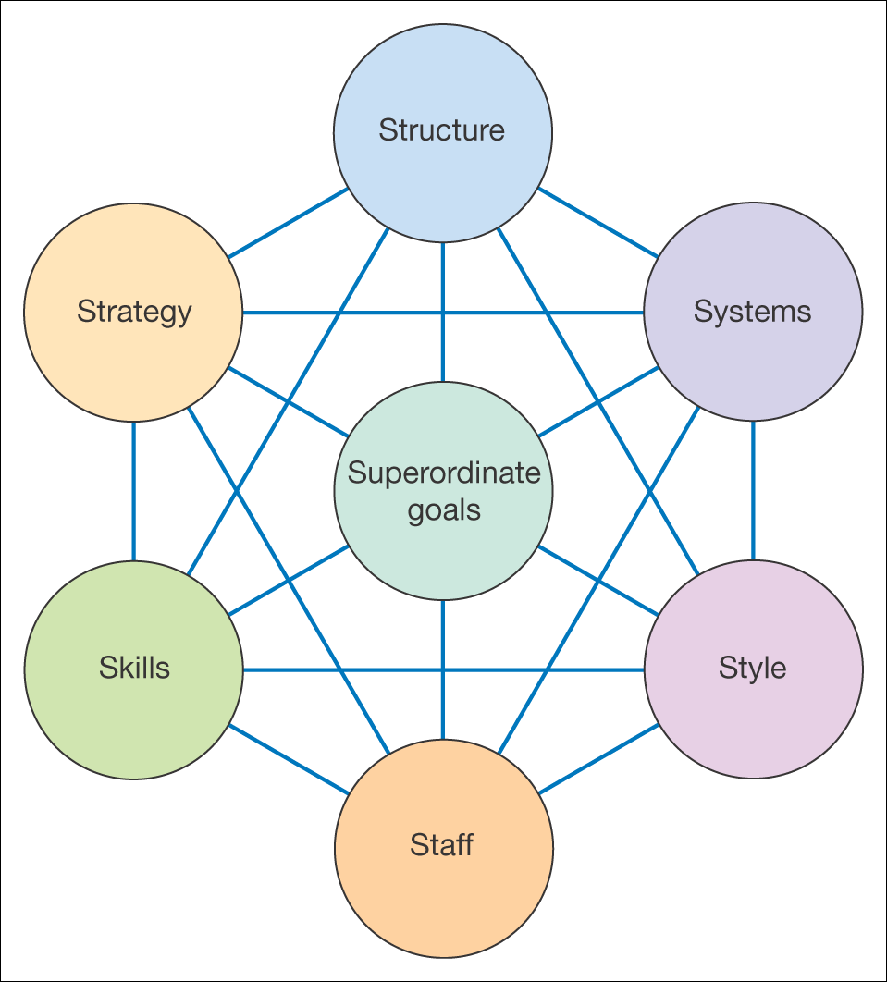
Figure 1.10 The McKinsey 7S framework
Source: Adapted from Waterman et al. (1980)

